Slide 1
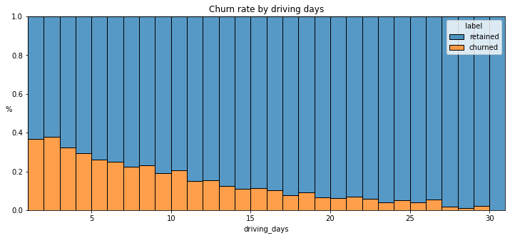
User Churn Project | Exploratory Data Analysis
The purpose of this project is to conduct exploratory data analysis (EDA) on a provided dataset.
Project Overview
Develop a machine learning model to predict user churn. An accurate model will help prevent churn, improve user retention, and grow Waze’s business.
The sessions variable is a right-skewed distribution with half of the observations having 56 or fewer sessions. However, as indicated by the, some users have more than 700.
The drives information follows a distribution similar to the sessions variable. It is right-skewed, approximately log-normal, with a median of 48. However, some drivers had over 400 drives in the last month.
The total user tenure (i.e., number of days since onboarding) is a uniform distribution with values ranging from near-zero to ~3,500 (~9.5 years).
There are nearly twice as many iPhone users as Android users represented in this data. Device used did not affect user churn. rates.
Less than 18% of the users churned. ~82% of users were retained.
The churn rate tends to increase as the mean daily distance driven increases.
The churn rate is highest for people who didn't use Waze much during the last month. The more times they used the app, the less likely they were to churn. While 40% of the users who didn't use the app at all last month churned, nobody who used the app 30 days churned.
Half of the people in the dataset had 40% or more of their sessions in just the last month, yet the overall median time since onboarding is almost five years.
The churn rate is highest for people who didn't use Waze much during the last month
Investigate why long-distance users to discontinue using the app.
Run deeper statistical analyses on the variables in the data to determine their impact on user churn.
Fill missing values in the dataset.
Investigae why user engagement was high this past month.

